Slide 1
Wearing Predictive System
Project 8
Dalla Longa Emanuele
Milani Federico
Urzino Davide

Slide 2
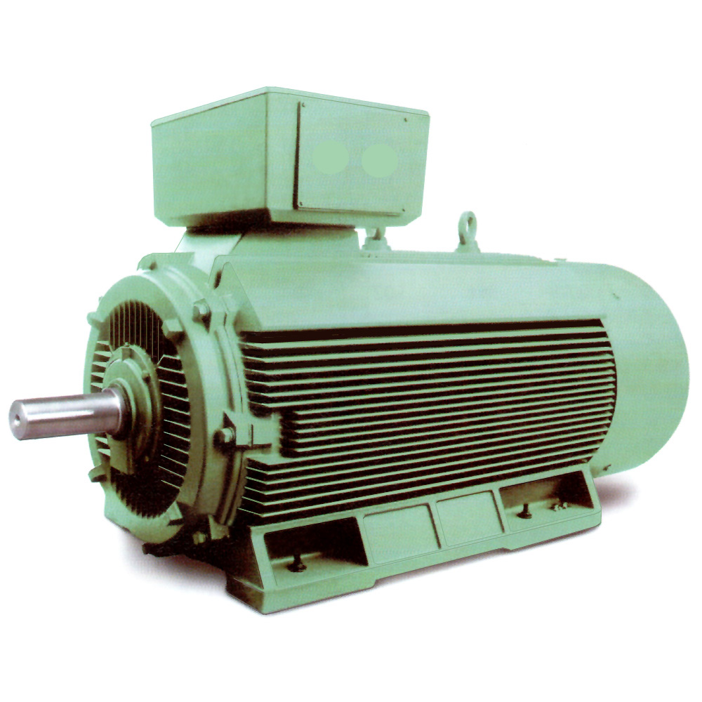
Project target
Detect faults on an industrial electric motor

Slide 3
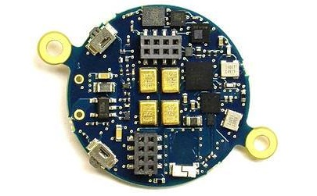
Platform
We used STM32 BlueCoin as our prototype board
Little platform which can be easily bolt on the motor without the need of modifications
Wide sensor capabilities (magnetometer, gyroscope, accelerometer)
SD card interface
Can be used for future iterations, which may need to exploit features like Bluetooth transmission, low power mode…

Slide 4
Workflow
We have three main tasks to tackle:
Data acquisition: we sense data using the BlueCoin board, and then collect them
The prototype we have developed in this iteration records data on a testbed, in a clean environment, free of interferences, at a given regime.
Data are logged on a SD card

Slide 5
Workflow
Model identification: we feed these data into a modeling algorithm, which estimates the system characteristics:
We have implemented an advanced modeling algorithm which estimates an AR(MA) model for each sensor axis, on a clean set of data

Slide 6
Workflow
Fault detection: we check the prediction performance of our model on the newly sensed data
If the performance of the prediction is worse than a certain threshold, we will know that the model has changed and the test will fail
The frequency of these checks will be proportional to the load applied
These checks will be operated more often in the first period of the motor’s life and near its expected end

Slide 7
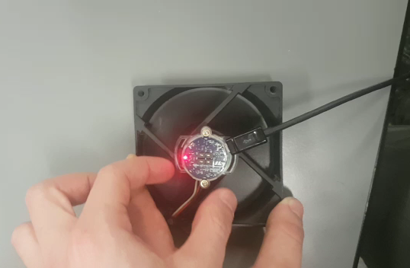
Acquisition demo

Slide 8
Experiments
We performed an experiment to verify the capabilities of the developed tools, using a fan rotating at the same speed as the motor
Data sensing on a working fan
Data sensing on a modified fan
Eccentrical load
Magnetic field
Model identification on the working fan data and performance verification on disturbed data

Slide 9
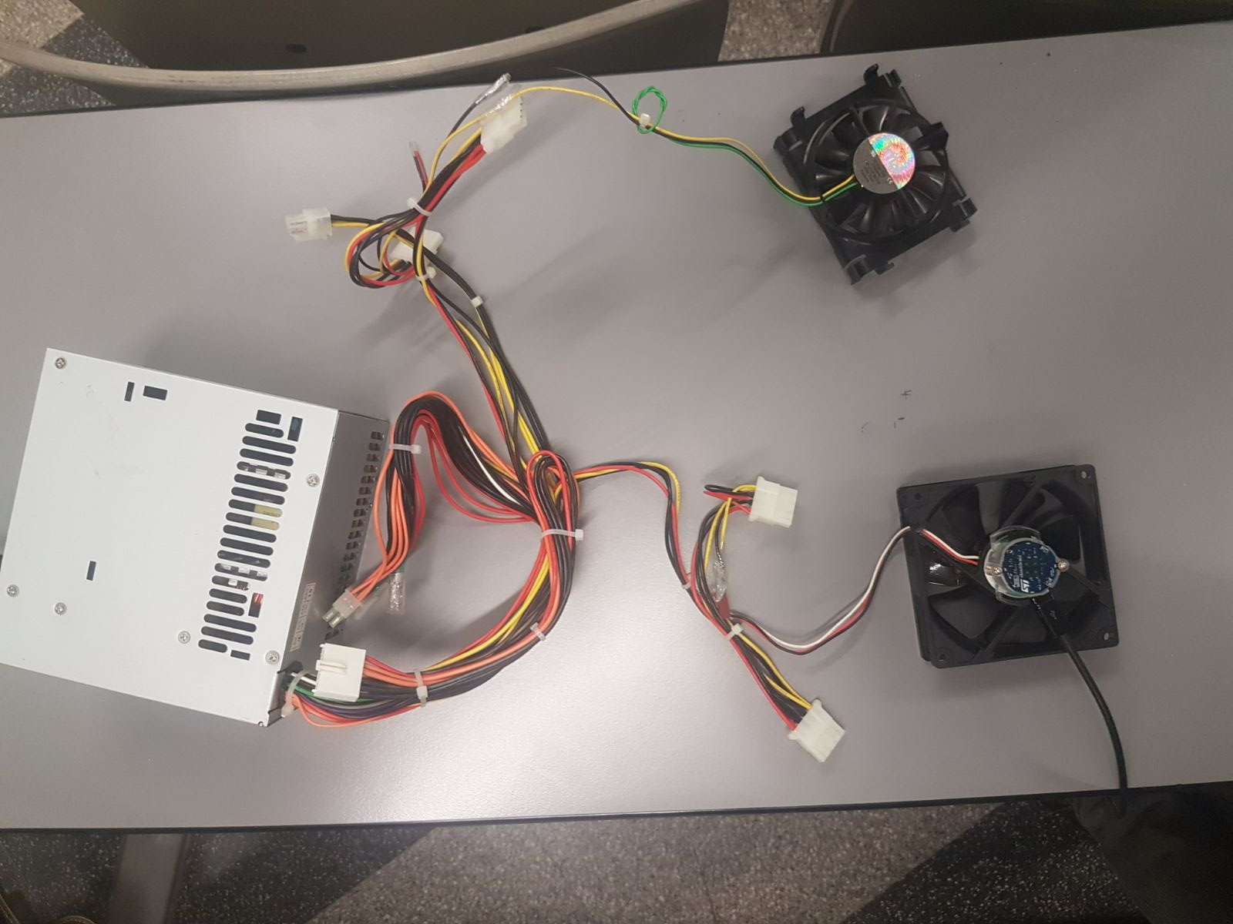
Experiments
We used two fans with a different diameter
The BlueCoin has been screwed on a plastic cradle taped to each fan

Slide 10
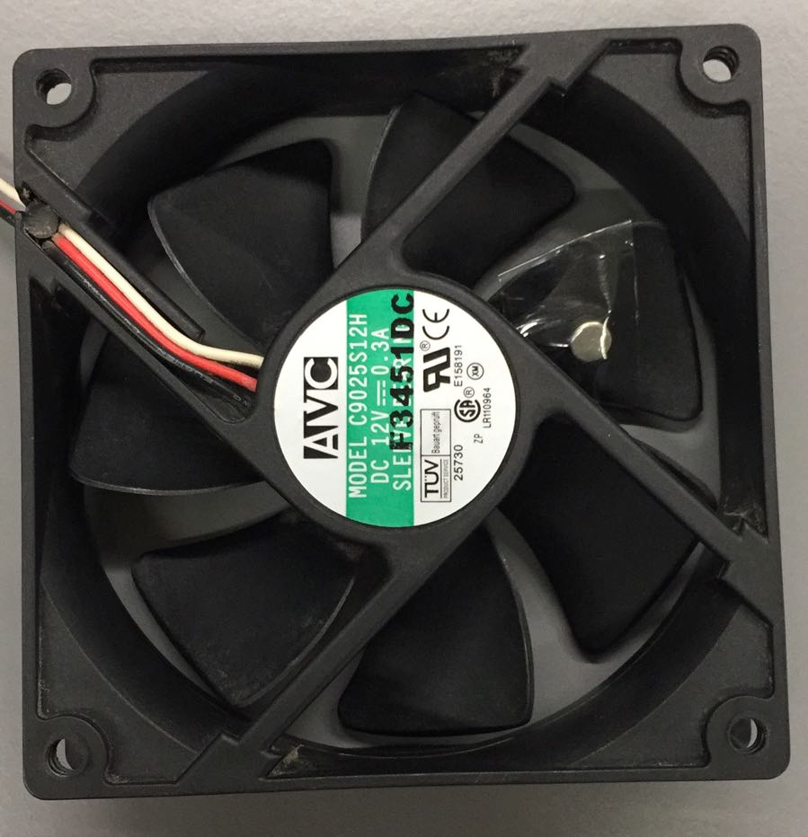
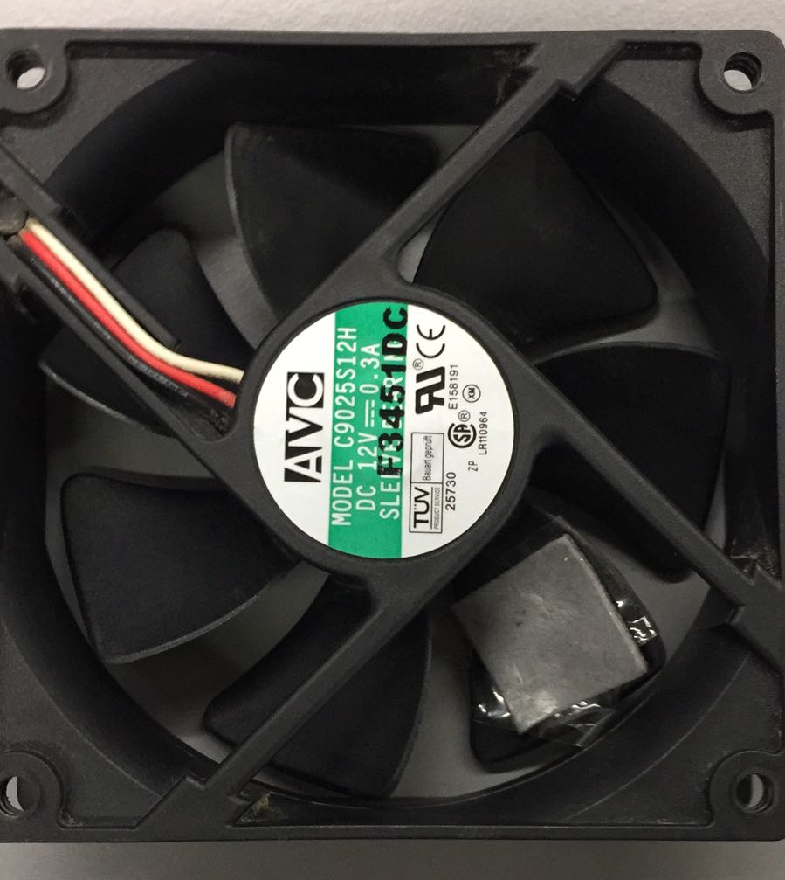
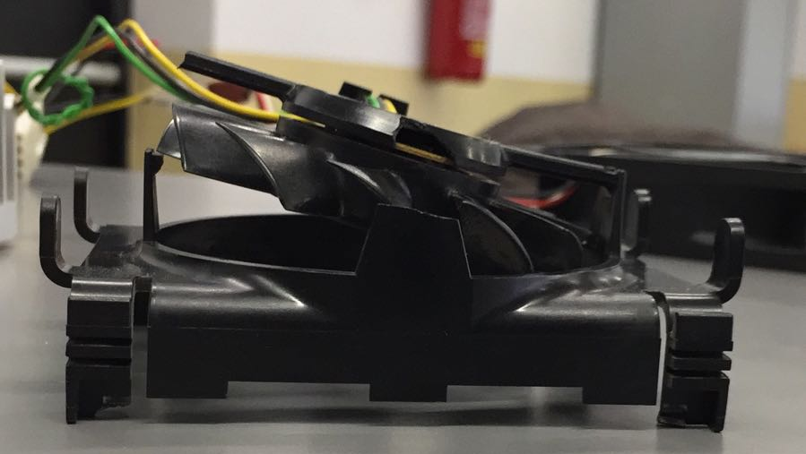
Experiments: modified conditions
We interfered with the rotation with a plastic rod
We added some tape on a blade of the fan
We taped a magnet on a blade of the fan
We broke one of the fan supports

Slide 11
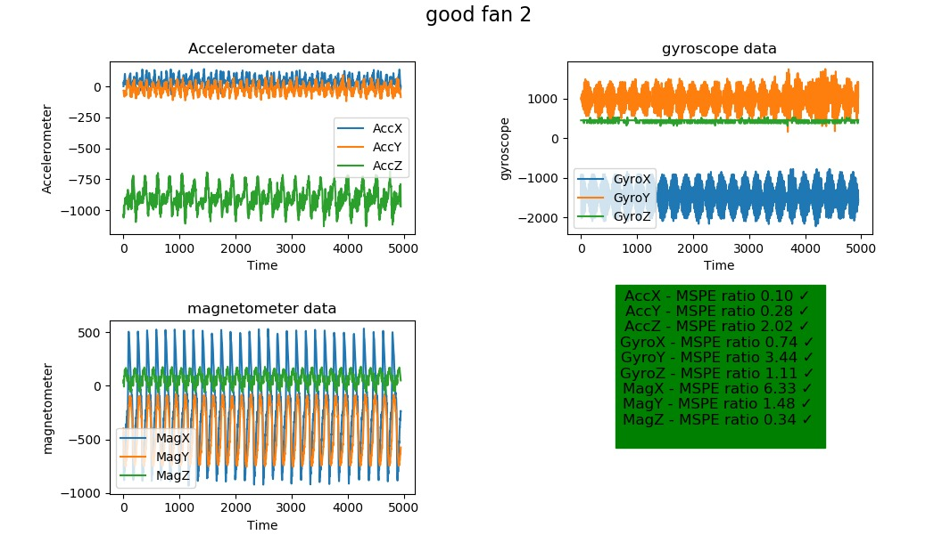
Results: testing on good data

Slide 12
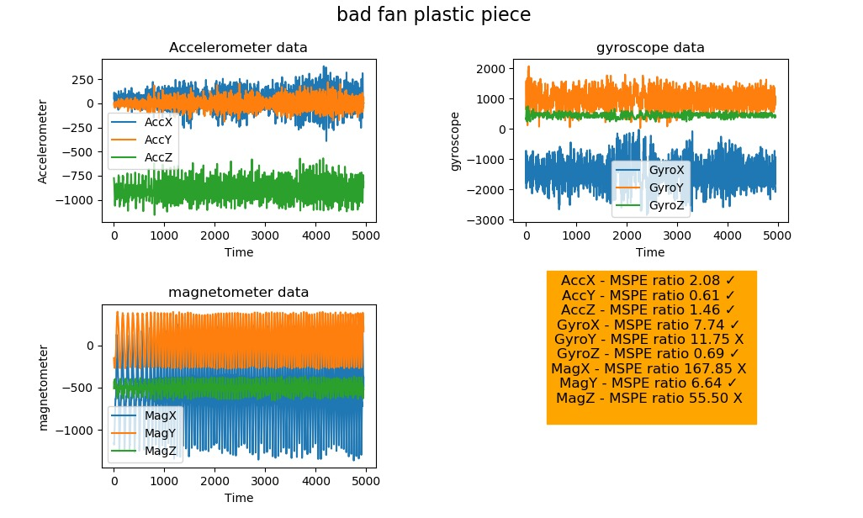
Results: plastic rod

Slide 13
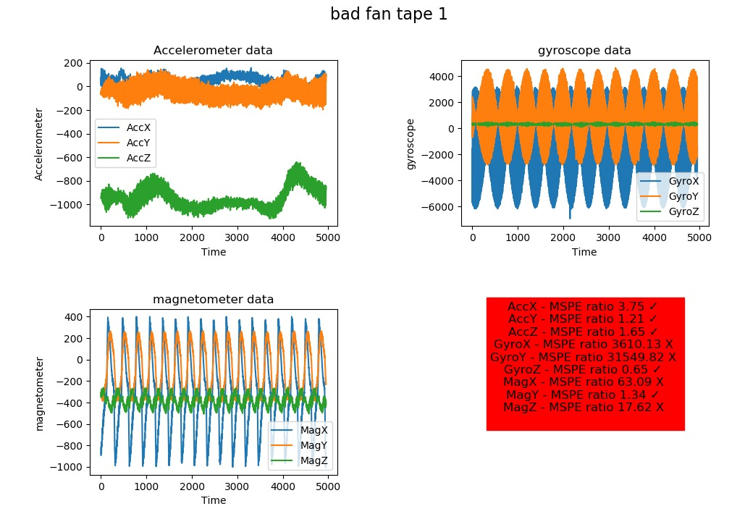
Results: taped blade

Slide 14
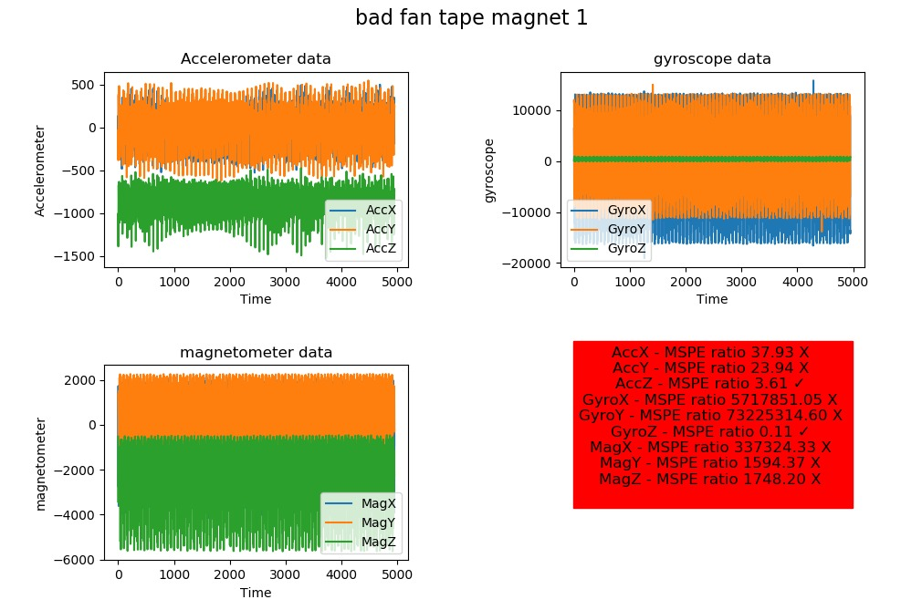
Results: magnet taped on blade

Slide 15
Future possibilities
Future iterations could provide online data sensing and collection. This configuration will need to handle further concerns, like:
Online data collection
Energy efficiency (harvesting?)
Drift (adaptivity)

